Slide 1

Comparative Study of ML models for Fraud Detection
By: Shilpika Banerjee
Math748
SFSU Fall’22

Slide 2

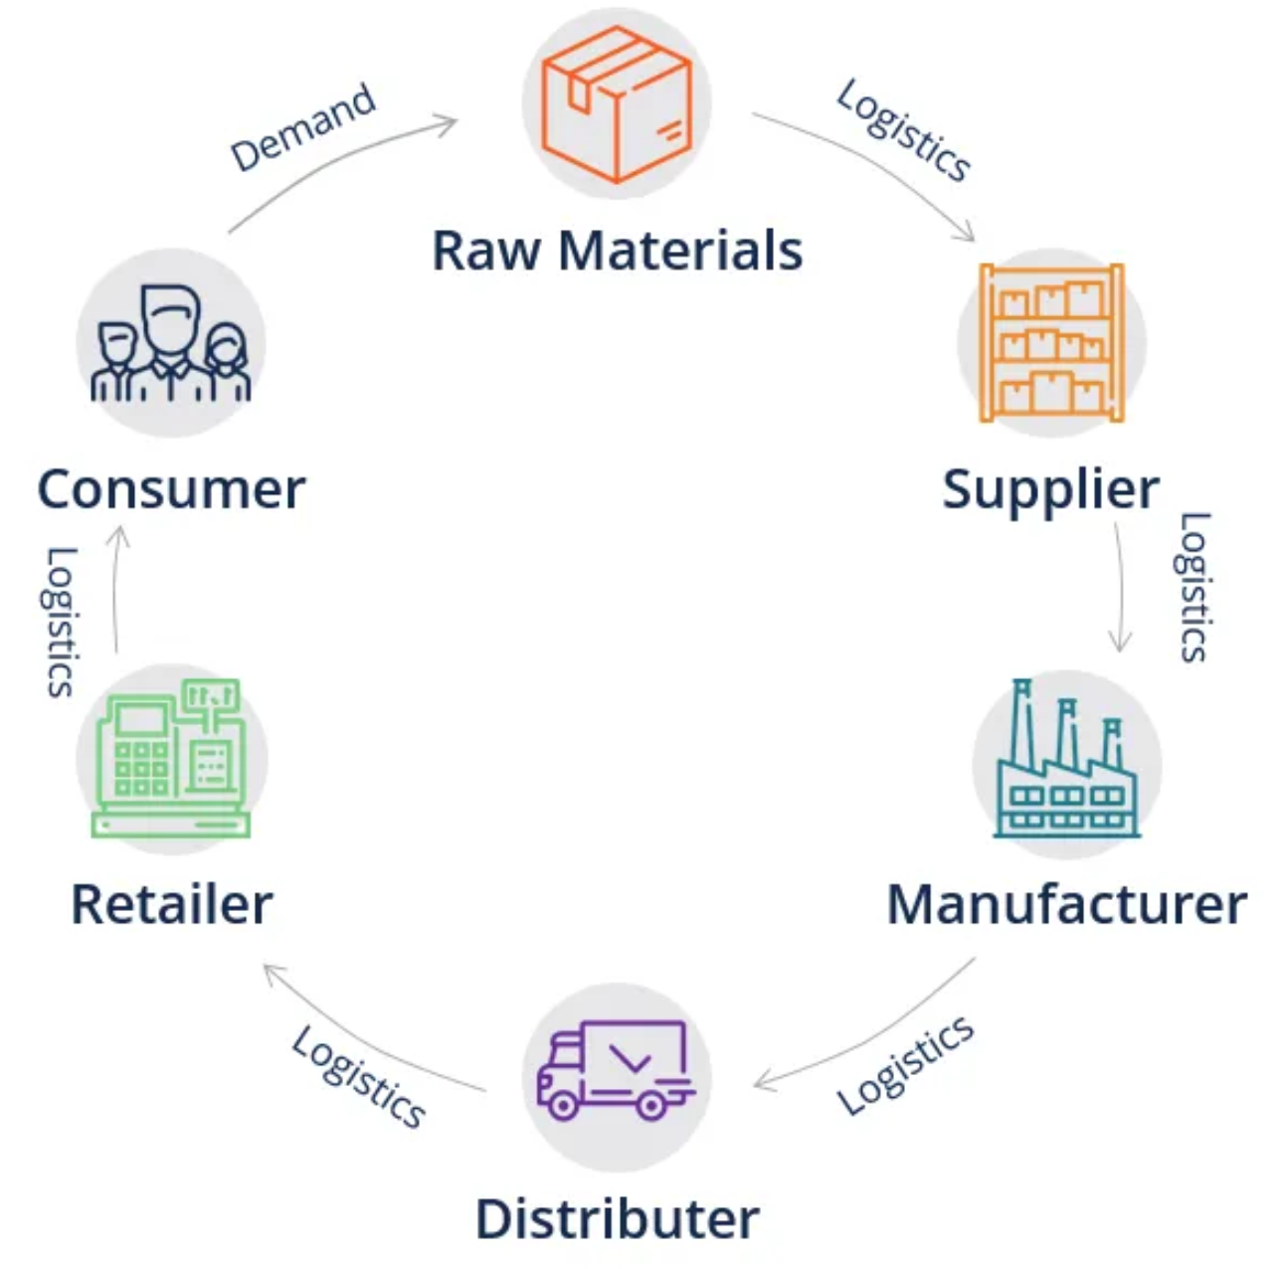

Introduction
The internet has revolutionized the way we shop. Online shopping has given us the freedom and comfort of shopping almost anything, at any time, and from anywhere.
Pros:
Convenience
Variety
Easy price comparisons
No sales pressure
Cons:
Risk of fraud
Delays
Lack of customized attention
Supply Chain: An entire system of producing and delivering a product or service, from sourcing the raw materials to the final delivery of the product or service to end users.
IoT devices in Supply Chain:
Reassures the location of the, both at rest and in motion.
Early identification of issues with goods getting lost or delayed.
Real-time shipment and inventory visibility and tracking.
Easier supply and demand.
Better quality management due to enhanced tracking information.
Efficient storage and distribution of products

Slide 3

Motivation & Objectives
IoT sensors are being deployed to share information in real-time which leads to the generation of a huge amount of data.
Use Supply Chain data can be used to make - predictions, recommendations, identify hidden patterns for better decision making in the future.
Detect potentially fraudulent transactions using supply chain.
Use different machine learning models to classify fraud transactions.
Compare the model performances.
Leverage the IoT sensor data to:
To predict potentially fraudulent transactions.
Compare the model performances.
Advantage to Company:
Proactively monitor for potentially fraudulent or high-risk events.
Detect illegitimate transactional behaviors online.
Provide alerts and analysis tools for administrators.

Slide 4
Project Plan
Data Set - Sourced from data.mendeley.com (Link).
The dataset consists of roughly 180k transactions from supply chains used by the company DataCo. Global for 3 years.
Project objective
Implement classification models to predict fraudulent transactions. Response variable: ‘Order_Status’ = ‘SUSPECTED_FRAUD’
Identify the key features that contribute towards identifying fraudulent transactions.
Compare the model performances using performance measures - Test Misclassification Error, Accuracy, and F1 scores.
Data Preprocessing
Feature Selection - Filter, Wrapper, Embedded methods
Classification Models -
LASSO Regularization
Elastic Net
Principal Component Analysis (PCA)
Logistic Regression
Decision Tree
Bagging and Random Forest
Boosting
k-Nearest Neighbors (KNN)

Slide 5
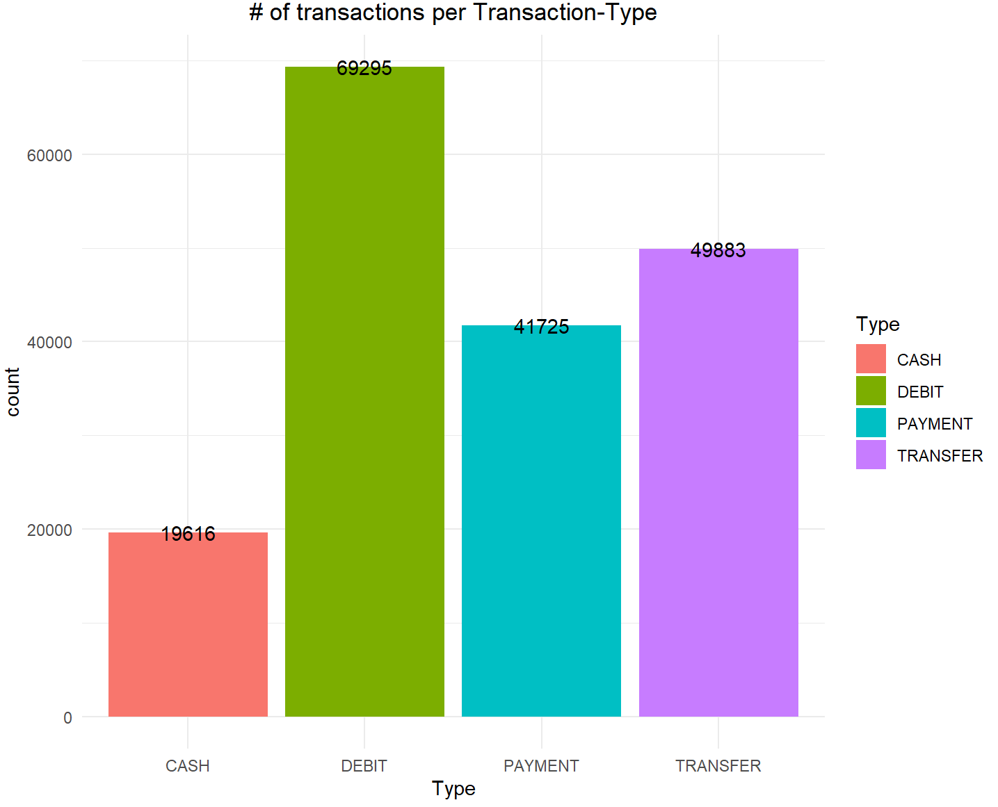
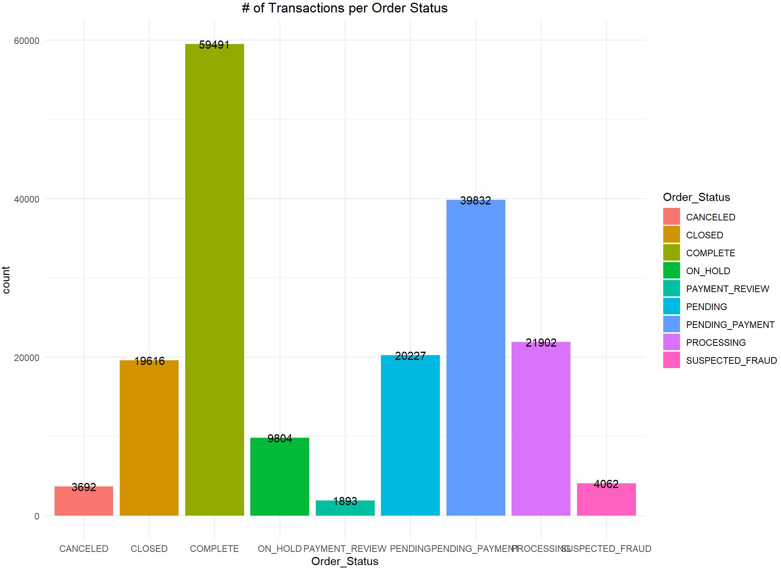
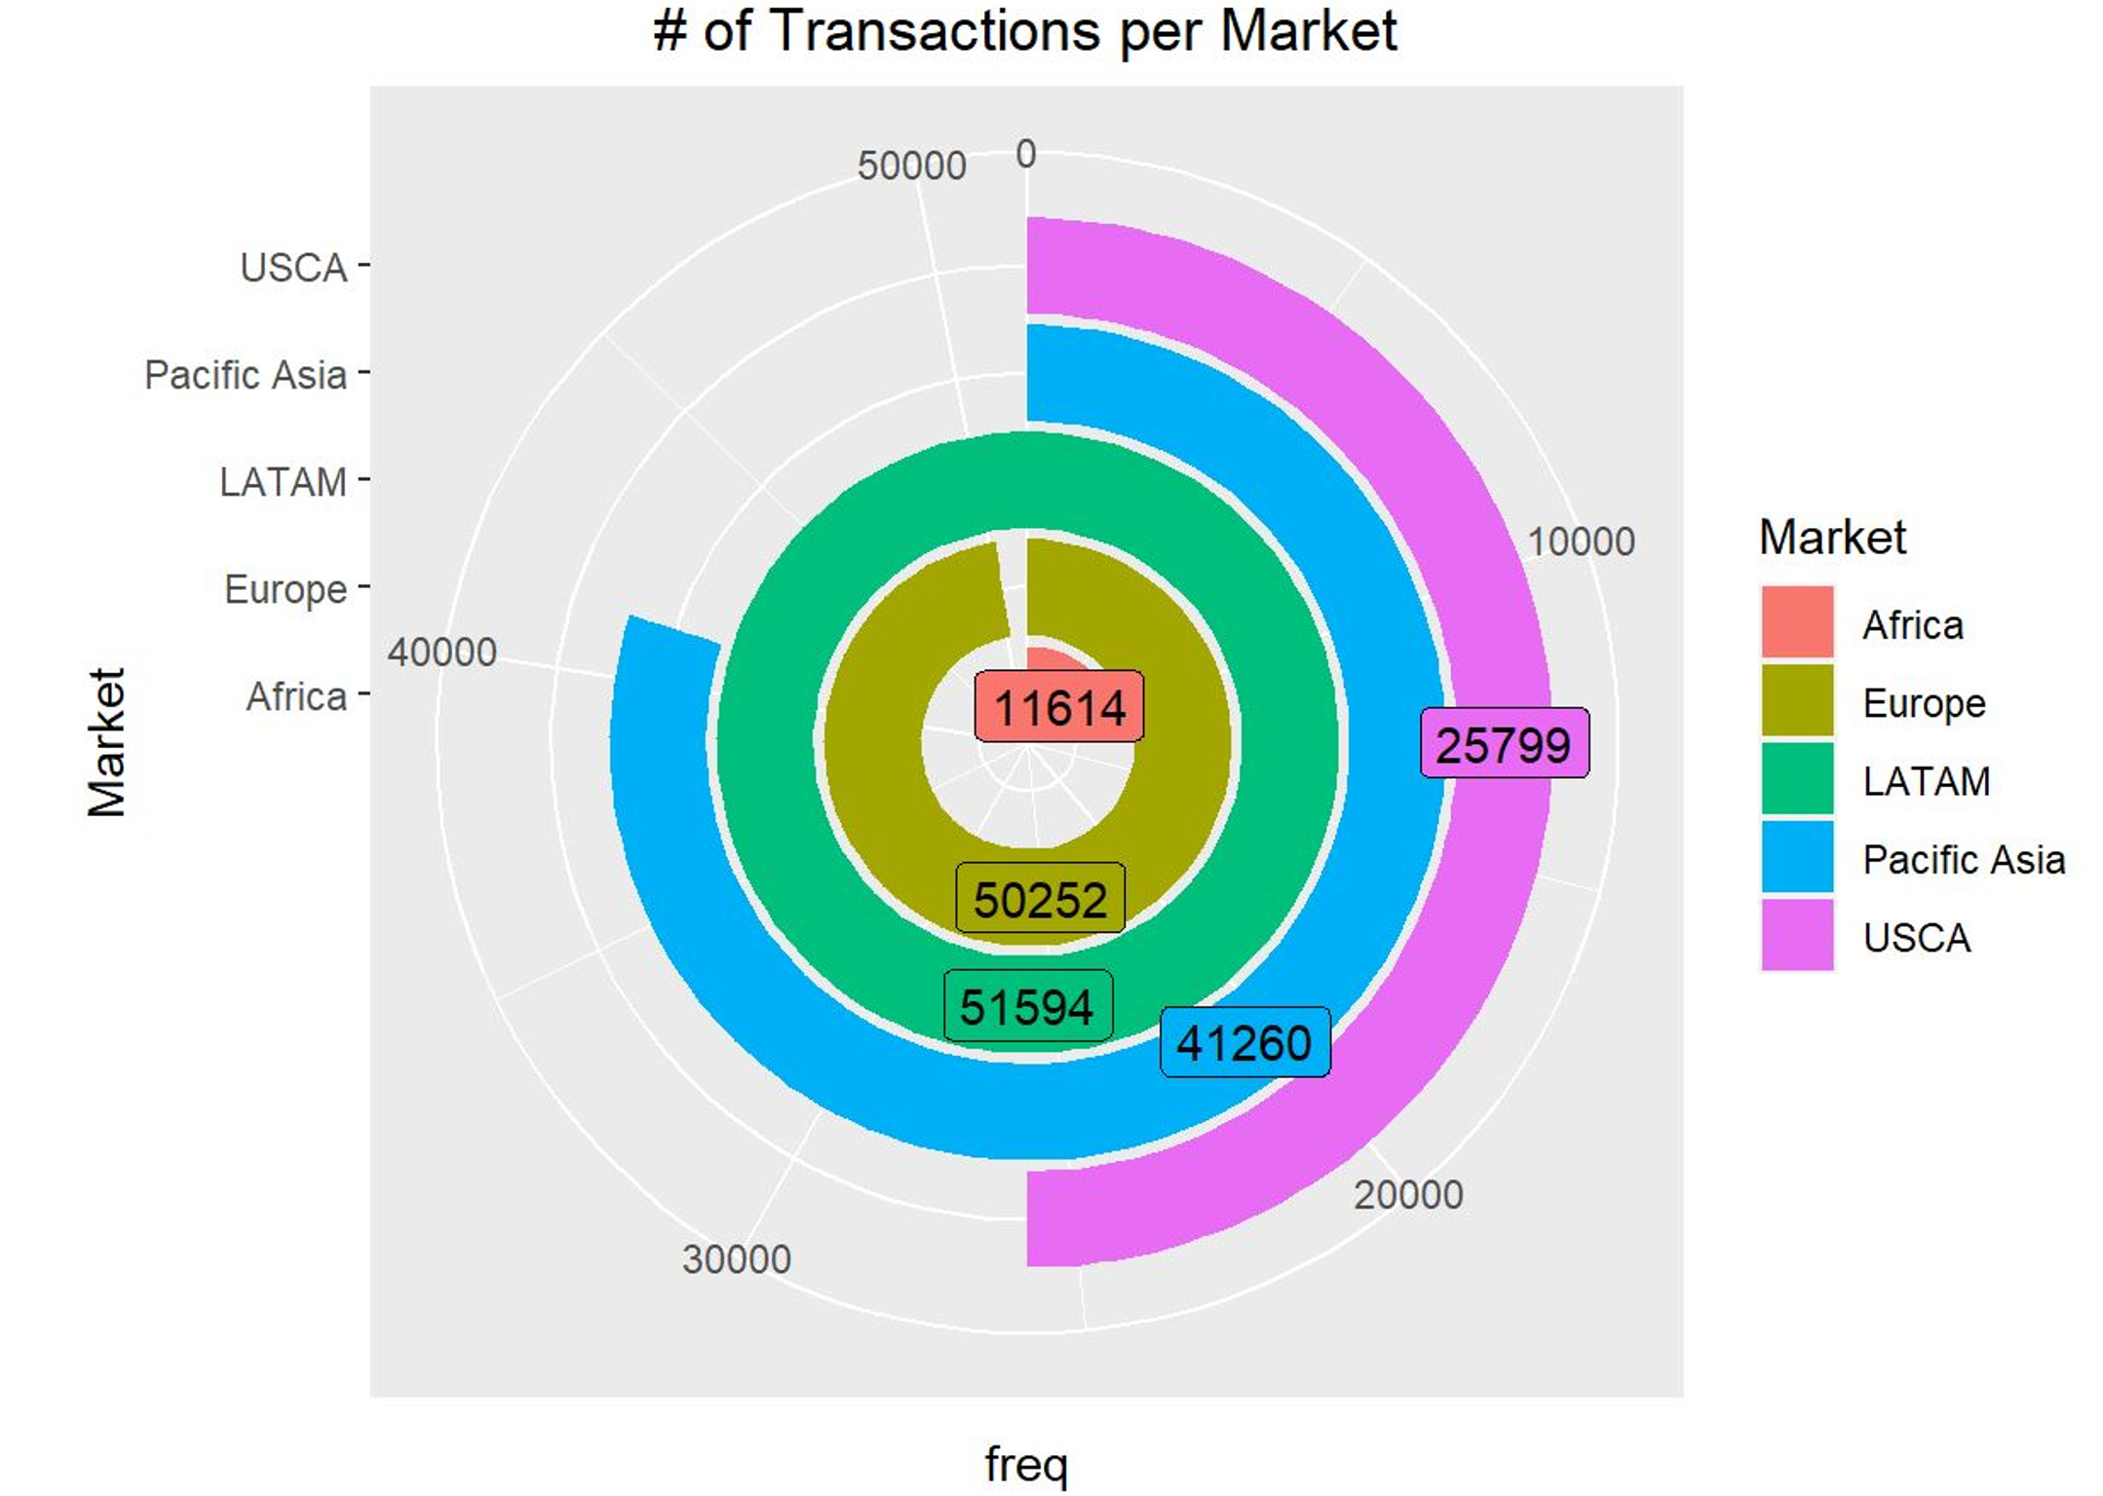
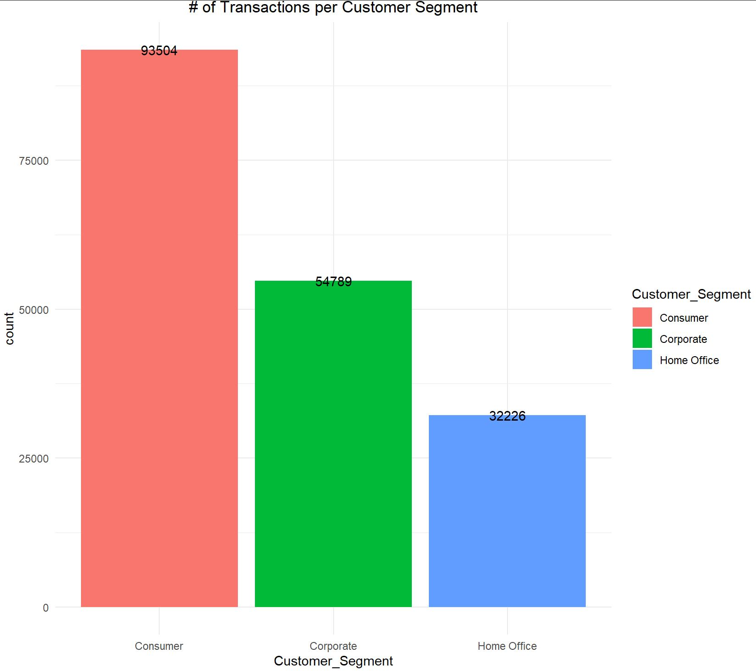
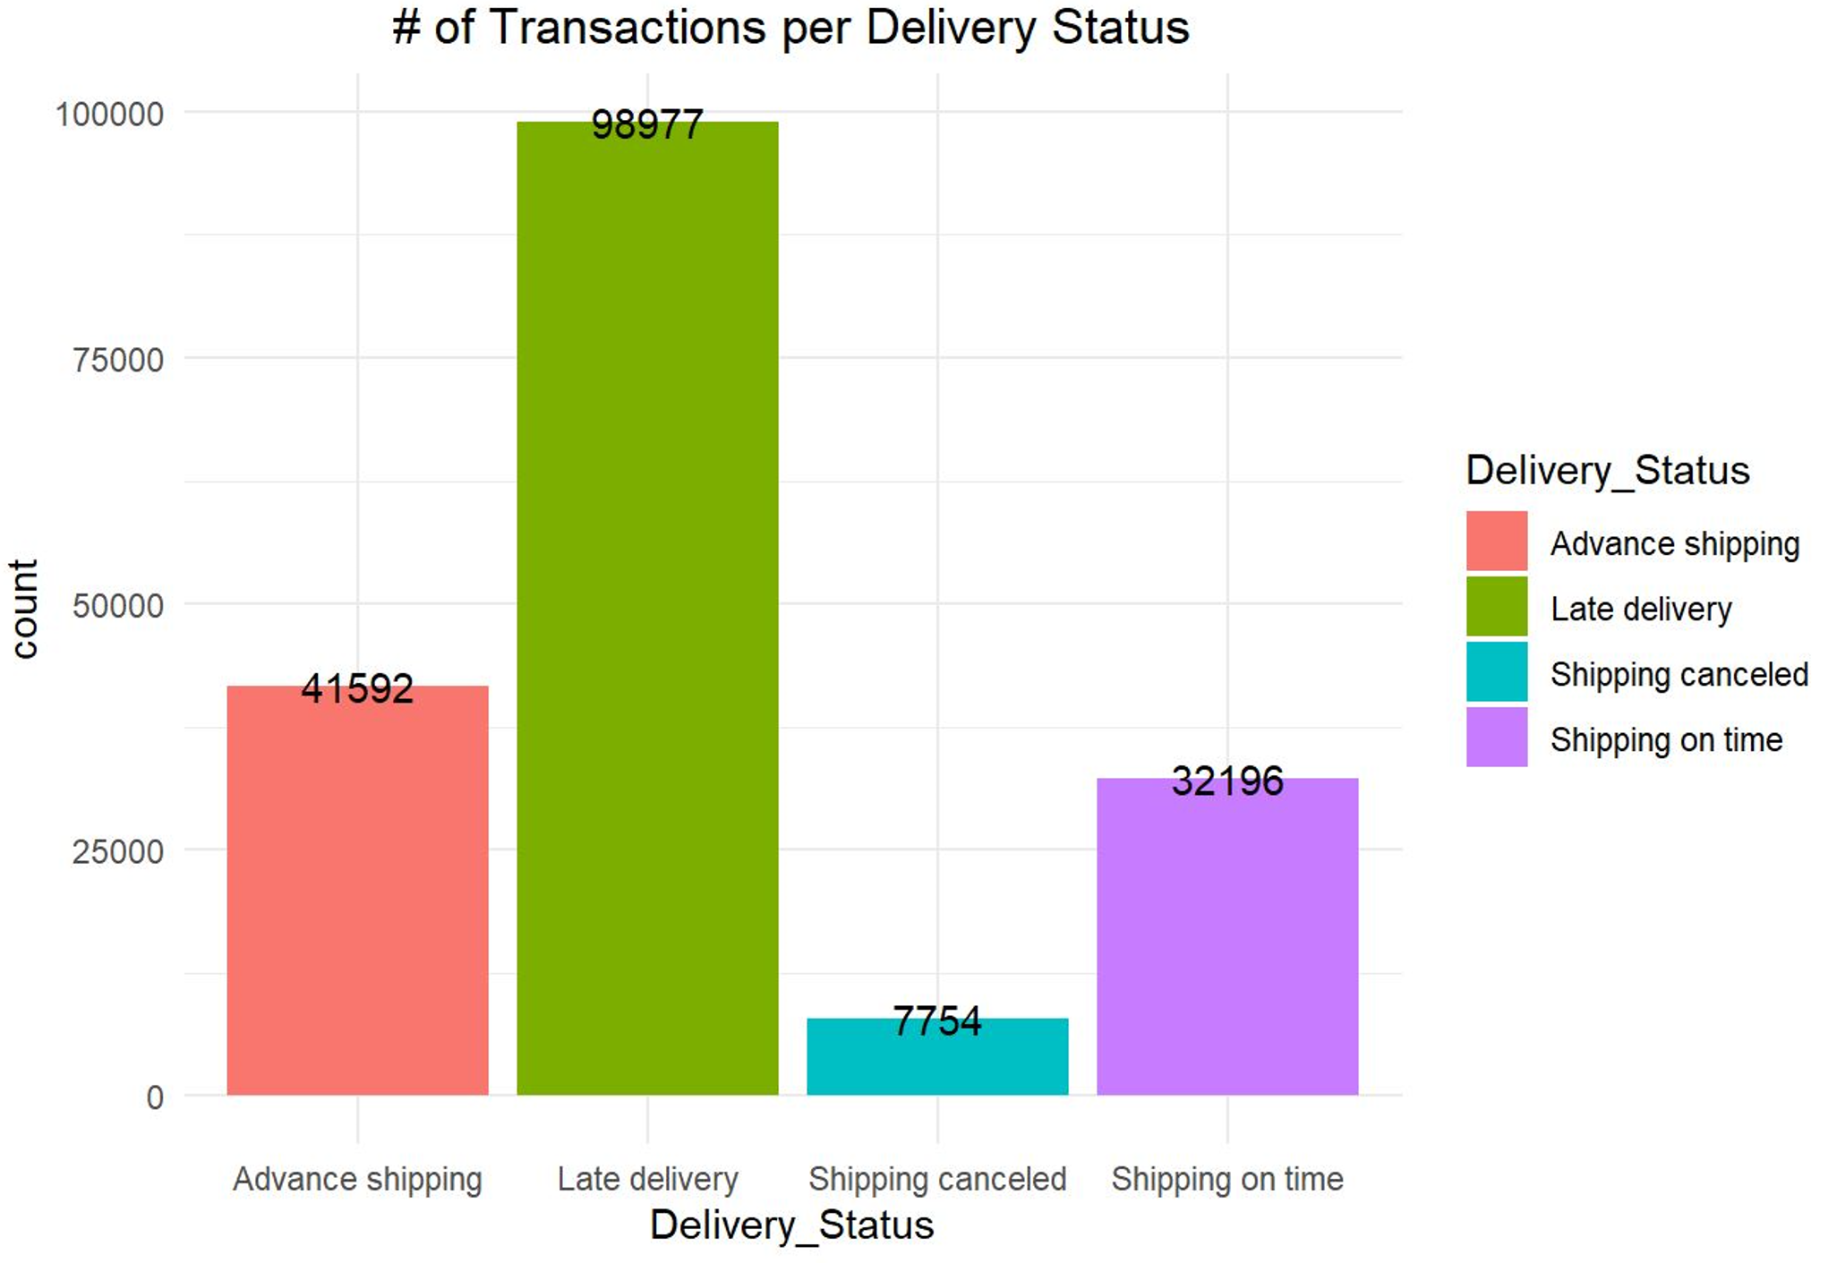
Data Visualization: Finding obvious patterns wrt. Transactions
Transaction Types
Order Status
Market Regions
Customer Segments
Delivery Status

Slide 6
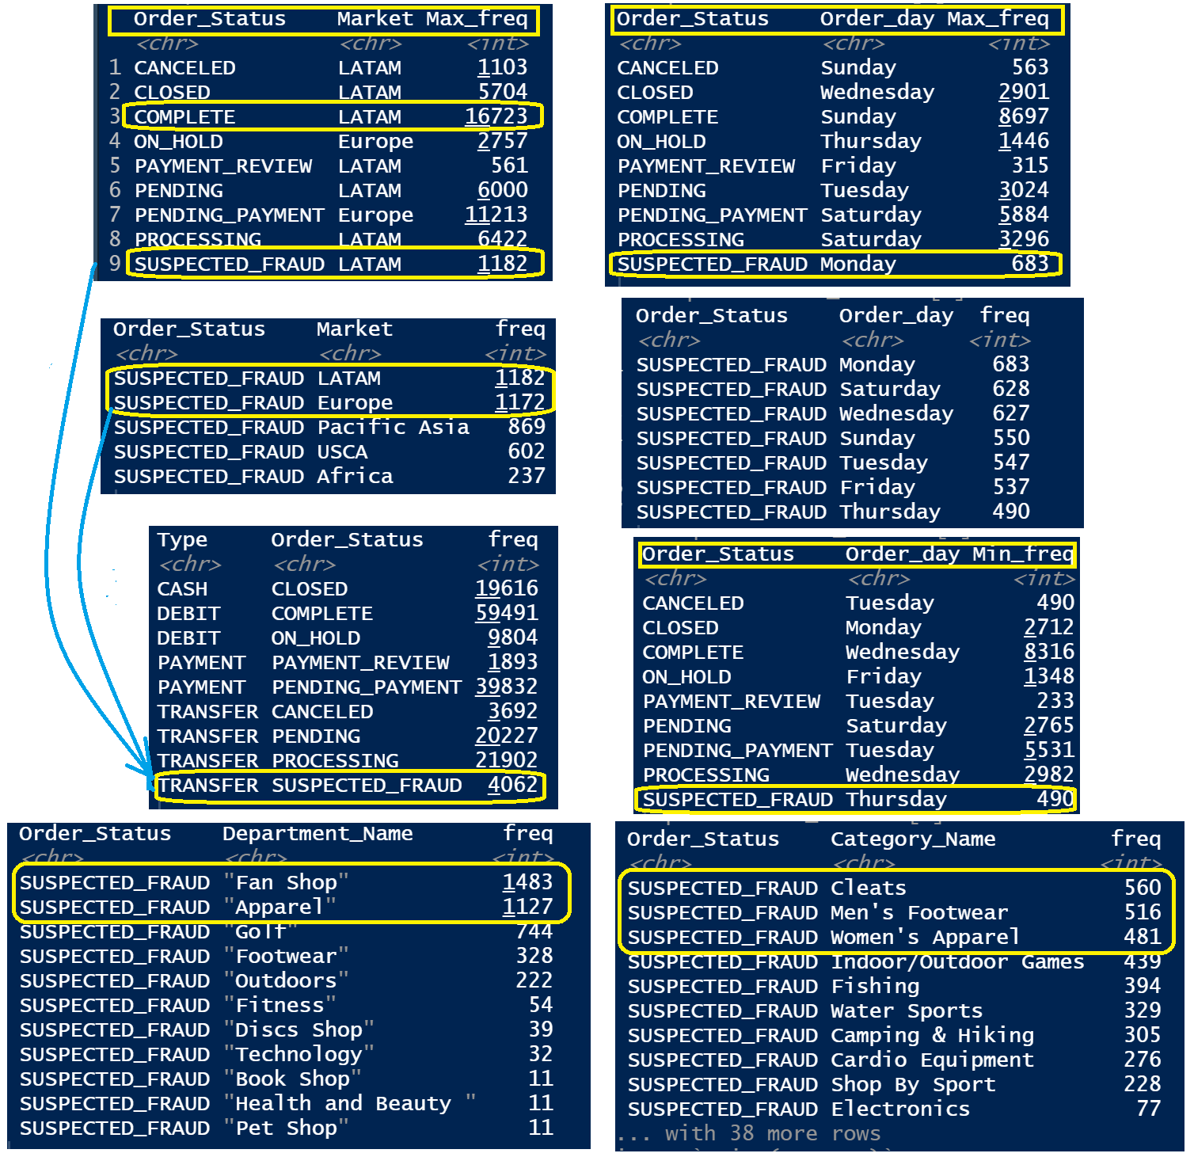
Data Visualization: with respect to Order Status (= SUSPECTED_FRAUD)
Observations for Max # of Frauds:
from LATAM & Europe
Transaction Type (all frauds) = Transfer (probably wire transfer)
Usually seen on Mondays.
Departments most affected = Fan Shop & Apparel.
Product Category = Cleats, Men’s Footwear, & Women’s Apparel.
Observations for Min # of Frauds:
from Africa
Usually seen on Thursdays.

Slide 7
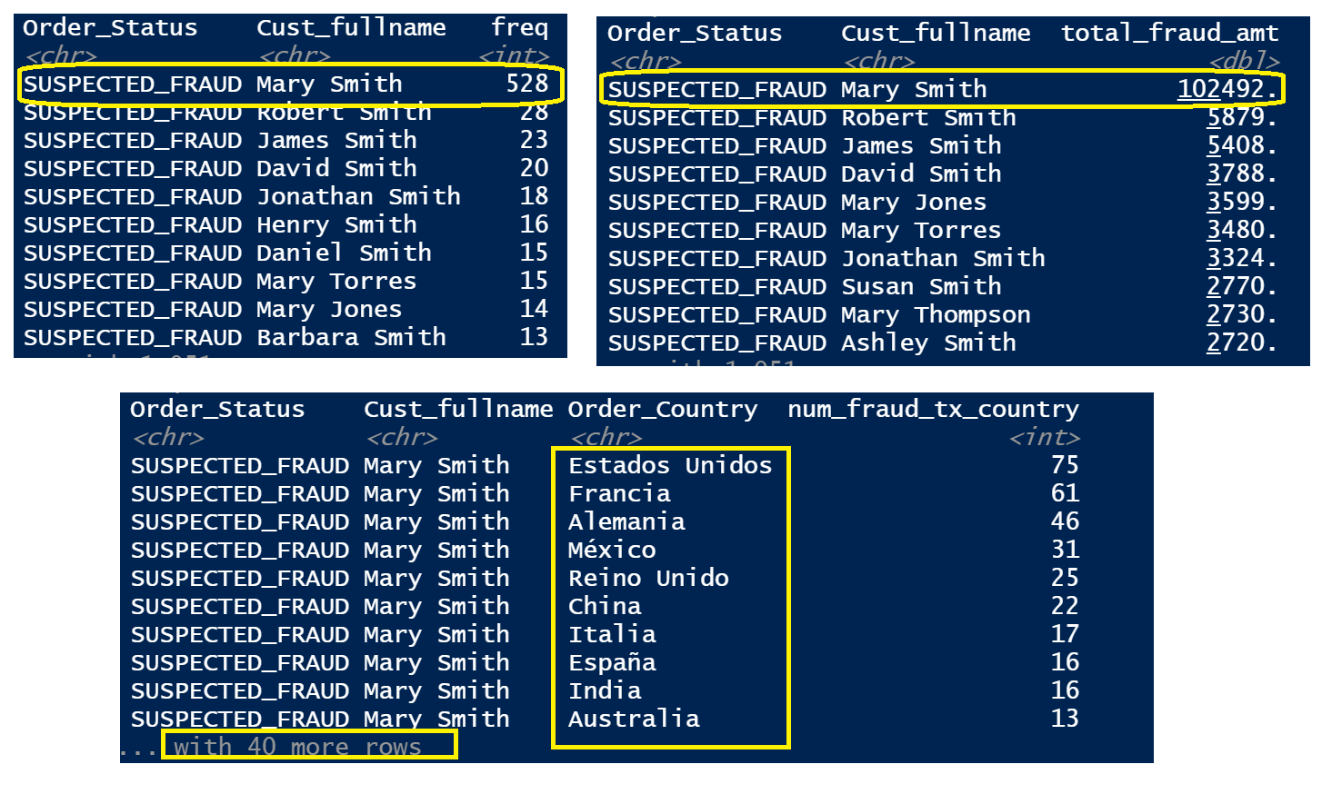
Data Visualization: with respect to Order Status (= SUSPECTED_FRAUD)
Max. # of fraudulent transactions:
User = ‘Mary Smith’
$ value = $102,492
Transactions via multiple countries and different customer addresses.

Slide 8
Data Preprocessing
Removed columns
Columns > 60% missing data. (Order_Zipcode, Product_Description)
Zero-variance columns (Customer_Email, Customer_Password, Product_Status)
URL column (Product_Image)
Removed rows
Rows with missing values or NA. (3 Rows)
Added New Columns
Extracted year, month, day, and hours from Order_date and Shipping_date.
Concatenated Customer first and last names. Cust_fullname
Response variable: response_fraud = 1 (Order_Status = SUSPECTED_FRAUD); 0 (otherwise)
Columns Excluded for Fraud Detection Classification
Excluded irrelevant columns. (Order_Status, order_date, shipping_date, Shipping_month, Shipping_day, Shipping_hours, Delivery_Status, Late_delivery_risk, Customer_Fname, Customer_Lname, Latitude, Longitude)

Slide 9
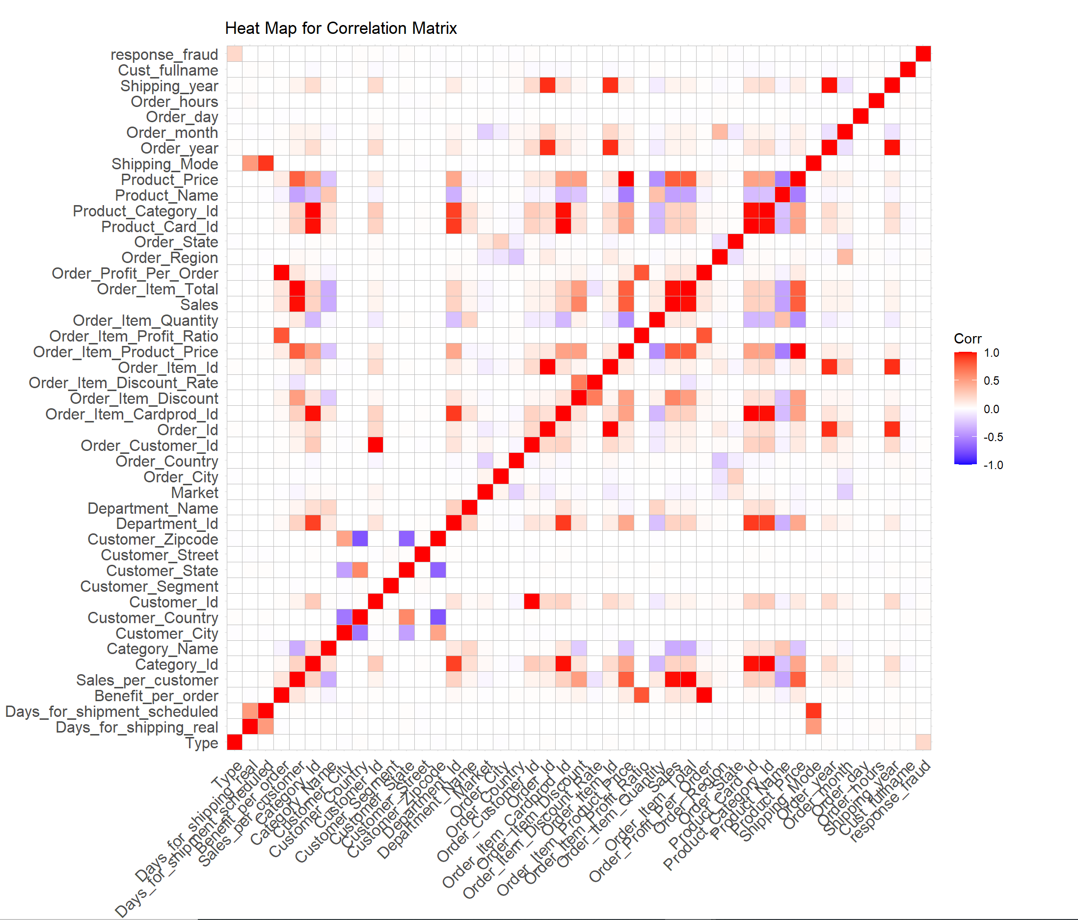
Feature Selection: Filter Method
Filter-based Variable Importance – Function filterVarImp()
ROC curve analysis is conducted on each predictor by thresholding the predictor variable and computing the AUC for each variable. The variables are ranked based on these values. Completely ignores how variables would behave in the presence of other variables.
Important variables: Type, Customer_Country, Customer_Id, Customer_Segment, Customer_State, Customer_Zipcode, Order_City, Order_Country, Order_Customer_Id, Order_Region, Order_State
Correlation Scores - using correlation matrix (top 10 features)
Important variables: Type, Customer_Id, Order_Customer_Id, Order_Region, Customer_Country, Order_State, Customer_Zipcode, Customer_Segment, Order_City.
Significant overlap between the Important Variables selected using the two Filter methods.

Slide 10
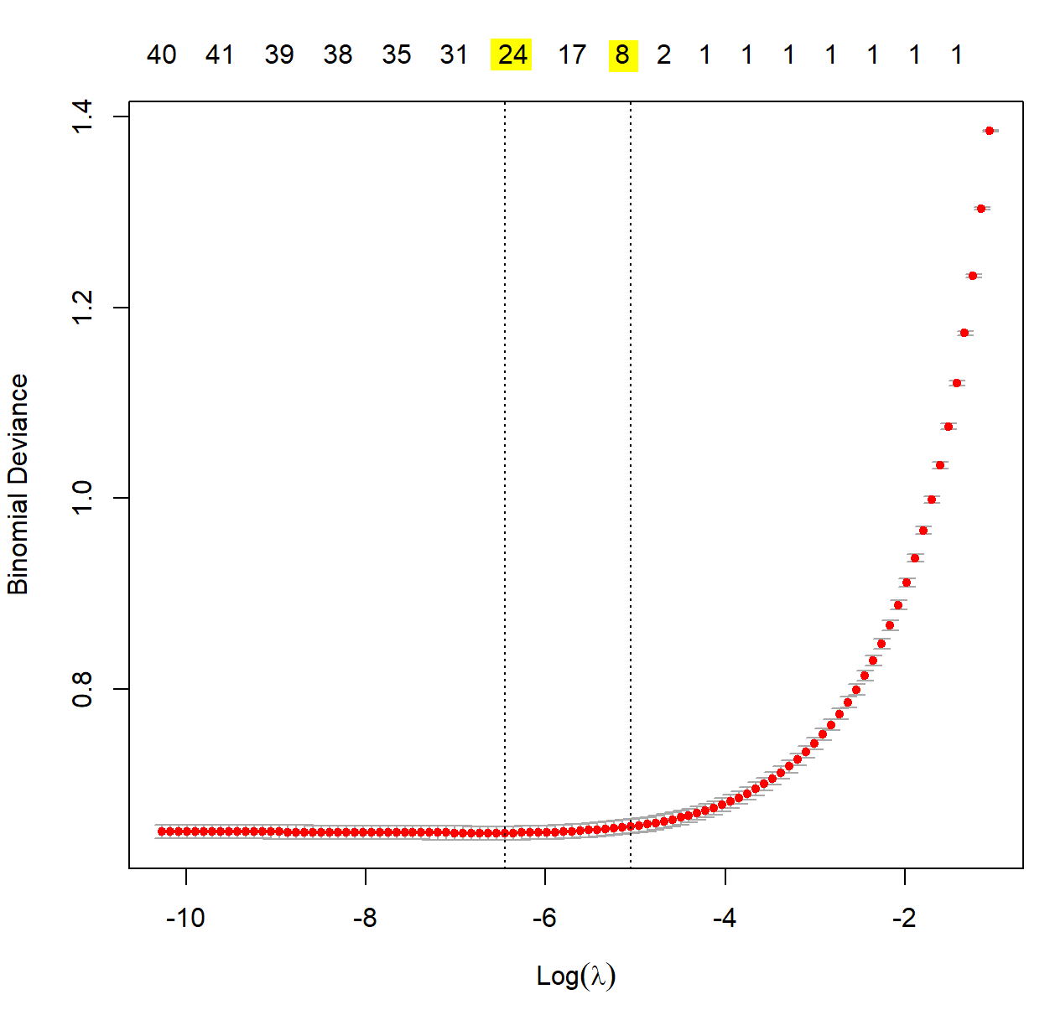
Feature Selection: Wrapper Method & Embedded Methods
Prior to applying Wrapper & Embedded methods for FS
Split entire data set into Training and Test Set. 70:30
Down Sample data set to mitigate imbalance of minority class.
Stepwise Regression Model – Direction = Both (Forward and Backward)
Important variables: Type, Customer_Street, Shipping_Mode
LASSO & Elastic Net (Shrinkage and Feature Selection)
Important variables (LASSO): Type, Customer_City, Shipping_Mode
Important variables (Elastic Net): Type
For Elastic Net, using Cross-validation, the best alpha = 0.88

Slide 11
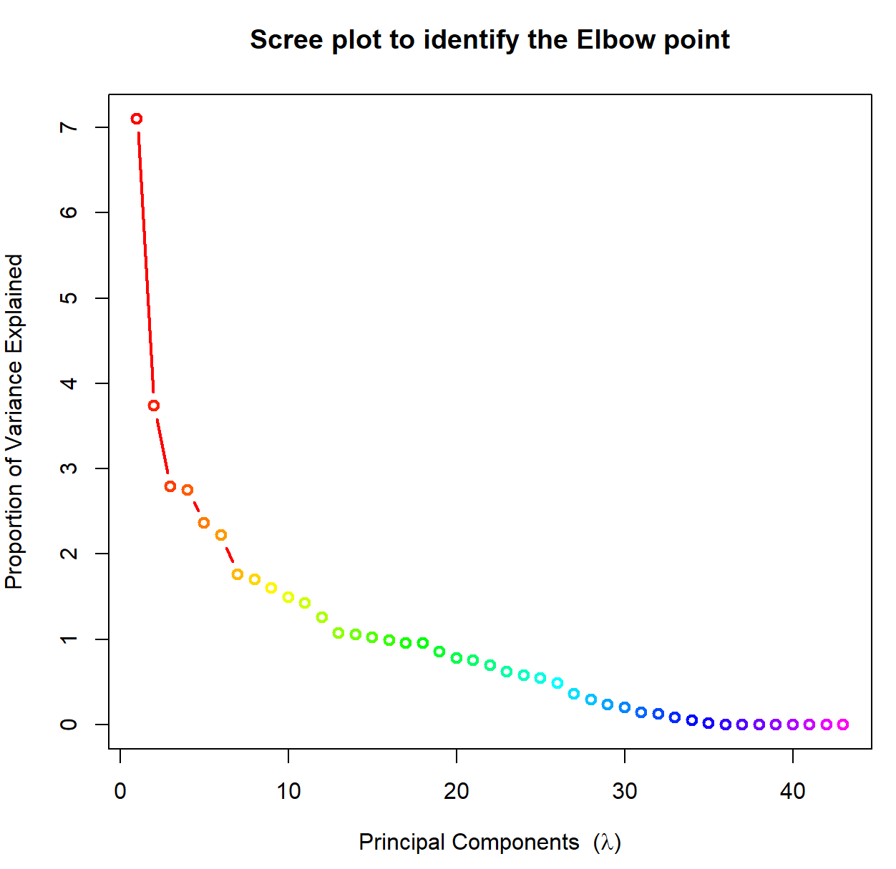
Classification Model: Logistic Regression& PCA
Logistic Regression
Important variables (at significance level = 0.1): Customer_City, Order_Country, Shipping_Mode
Principal Component Analysis (PCA)
Scree Plot shows an elbow point around the 10th lambda.
Model is build using first 9 principal components that explain ~63% of the total variance.

Slide 12
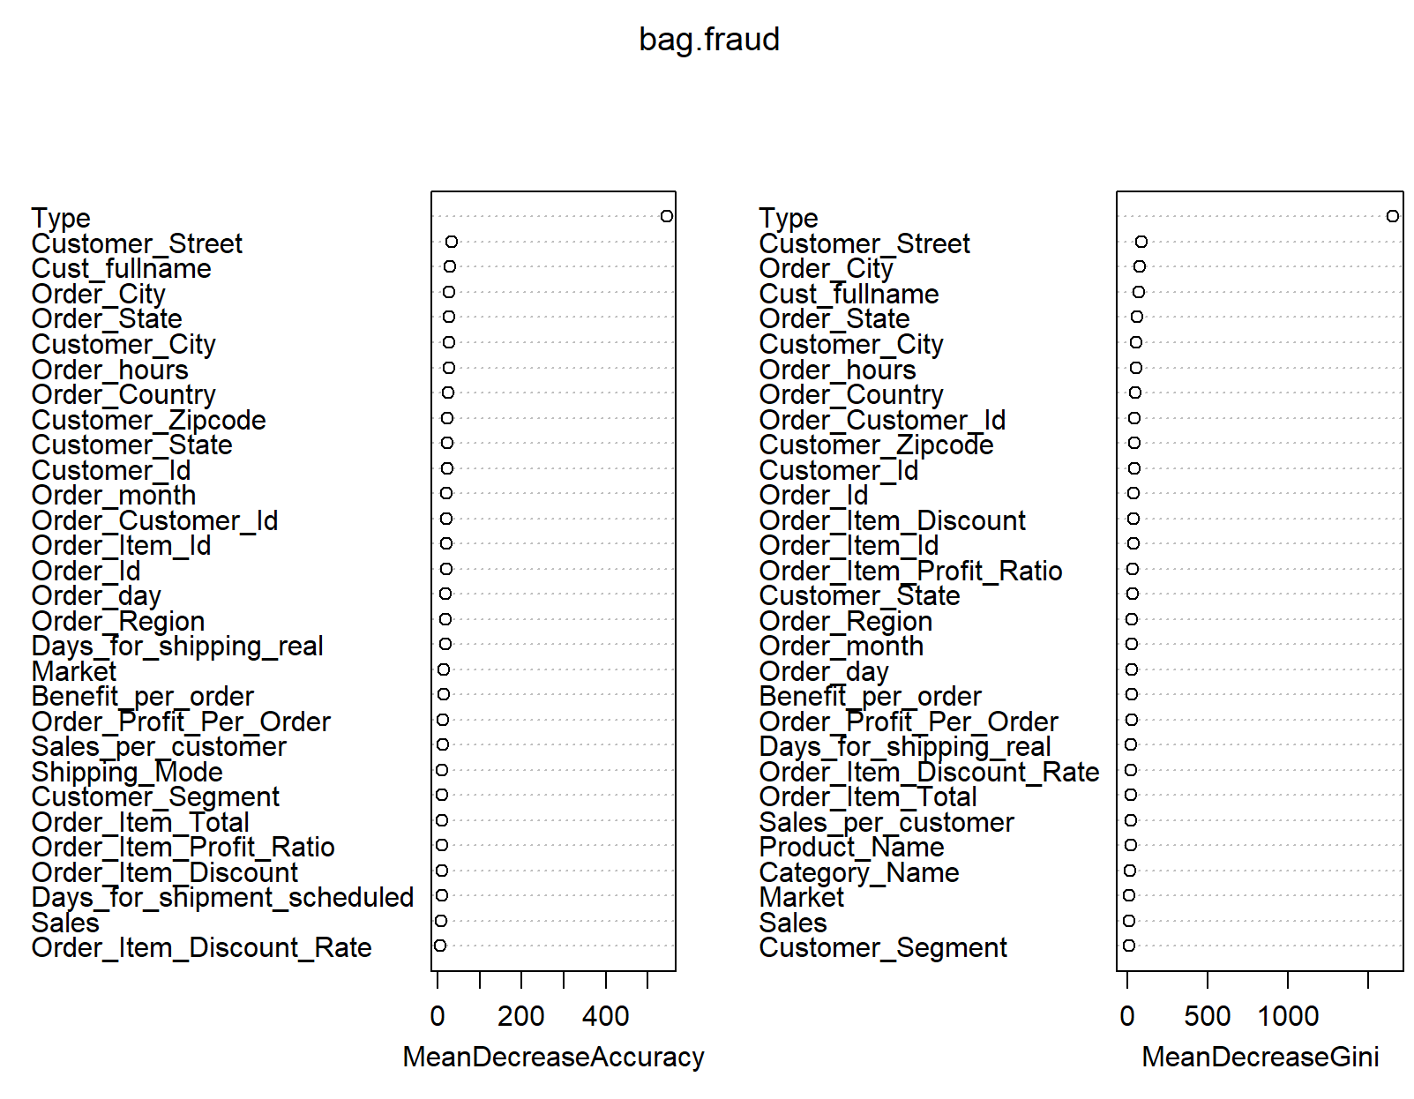
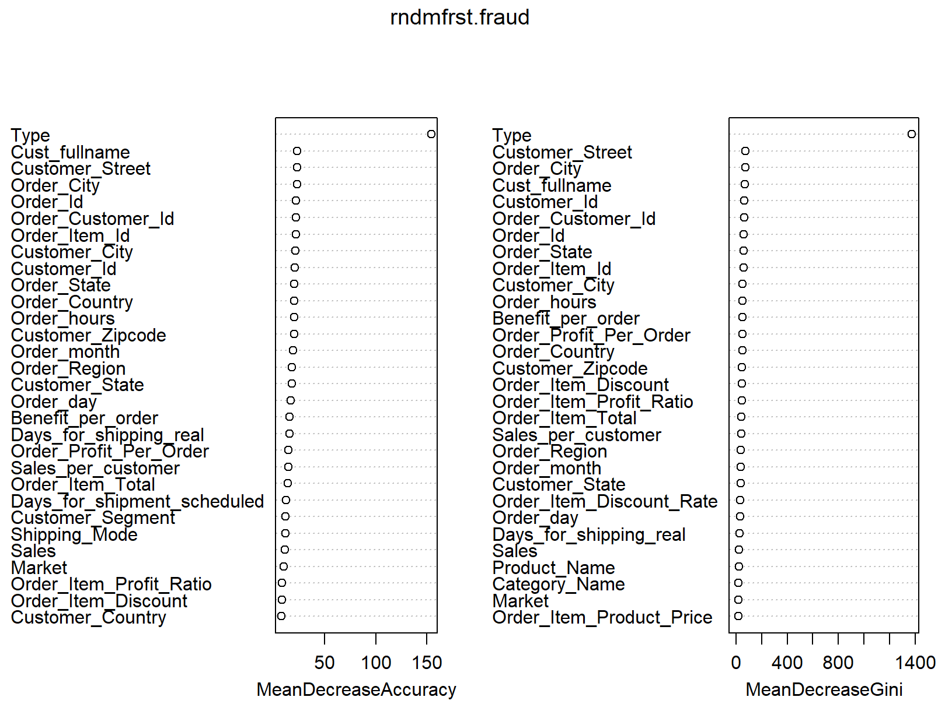
Classification Model: Bagging (m=p) and Random Forest (m=√p)

Slide 13
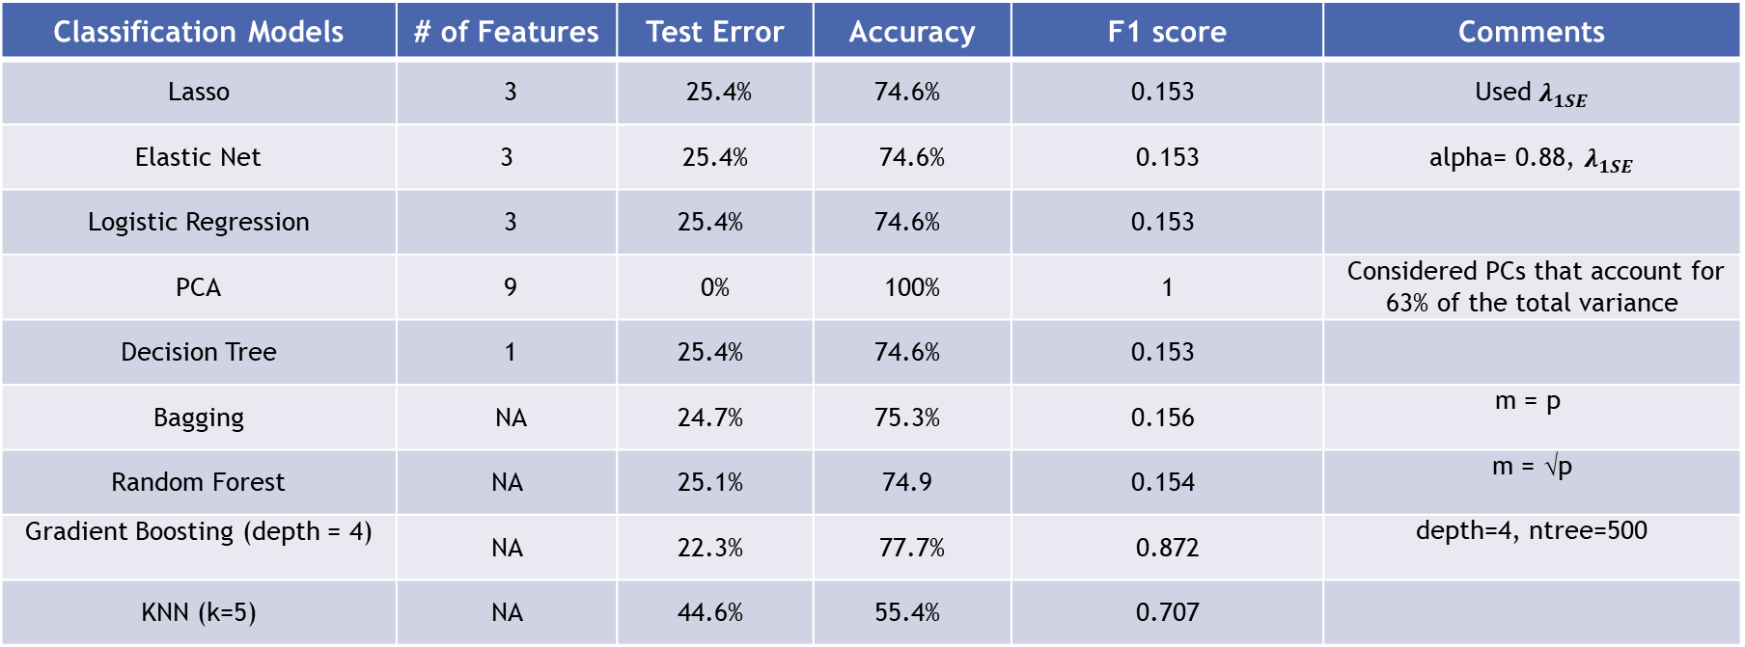
Performance Analysis of Fraud Detecting Models
Classification Models | # of Features | Test Error | Accuracy | F1 score | Comments
Lasso | 3 | 25.4% | 74.6% | 0.153 | Used $λ_{1SE}$
Elastic Net | 3 | 25.4% | 74.6% | 0.153 | alpha= 0.88, $λ_{1SE}$
Logistic Regression | 3 | 25.4% | 74.6% | 0.153
PCA | 9 | 0% | 100% | 1 | Considered PCs that account for 63% of the total variance
Decision Tree | 1 | 25.4% | 74.6% | 0.153
Bagging | NA | 24.7% | 75.3% | 0.156 | m = p
Random Forest | NA | 25.1% | 74.9 | 0.154 | m = √p
Gradient Boosting (depth = 4) | NA | 22.3% | 77.7% | 0.872 | depth=4, ntree=500
KNN (k=5) | NA | 44.6% | 55.4% | 0.707

Slide 14
Conclusion and Future work
The feature selection using the Filter methods extracted roughly 10-12 features which were almost similar between the two techniques.
The Wrapper and the Embedded methods, which use the classifiers to make inferences, led to just a handful of the features. ‘Shipping_Mode’ does not seem to be a relevant feature for fraud detection and hence should be removed from the classification model.
‘Type’ and ‘Customer_Street’ are emerging as the two most significant features for fraud detection.
The performance of Principal Component Analysis outperformed all the other models even though the PCs captured 63% of the total model variance.
Gradient Boosting using ‘interactive.depth = 4’ had the next best performance measures.
Future work could include drawing insights about purchase trends or identifying any prominent patternsin the fraudulent transactions using unsupervised learning (k-means clustering).

Slide 15
Thank You Questions?

